Slide 1
Discrete Mathematics: Lecture 22 Part IV. Graph Theory graph, vertex, edge, endpoints, directed, undirected, multiple edge, loop, complete graph, cycle, wheel, cube, graph representation
Xuming He
Associate Professor
School of Information Science and Technology
ShanghaiTech University
Spring Semester, 2024
Notes by Prof. Liangfeng Zhang and Xuming He

Slide 2
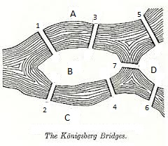
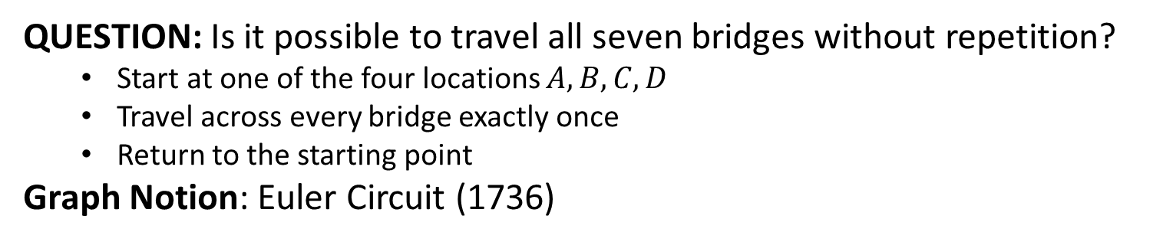
Seven Bridges of Königsberg
A
5
1
3
B
7
D
4
2
C
6
QUESTION: Is it possible to travel all seven bridges without repetition?
Start at one of the four locations $A,B,C,D$
Travel across every bridge exactly once
Return to the starting point
Graph Notion: Euler Circuit (1736)

Slide 3
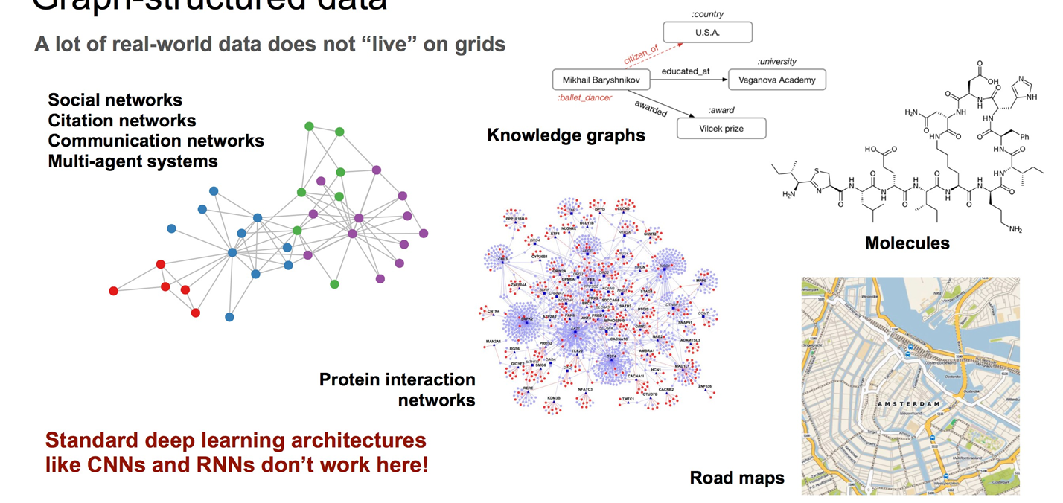
Real-world Graphs

Slide 4
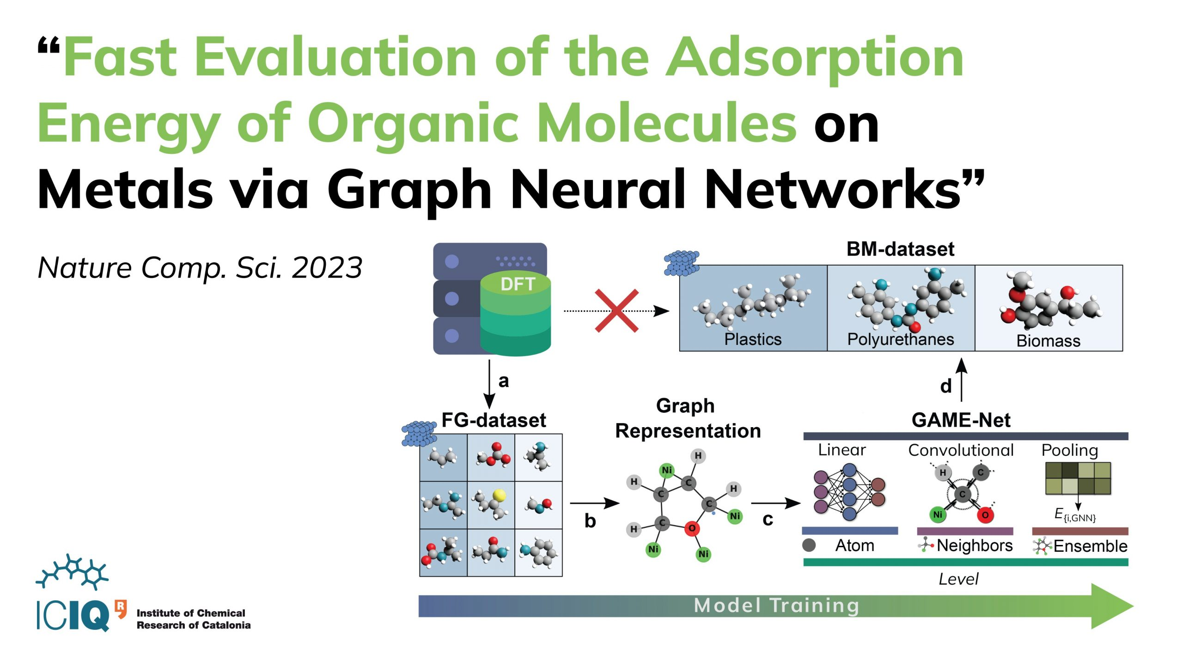
AI and Graphs

Slide 5
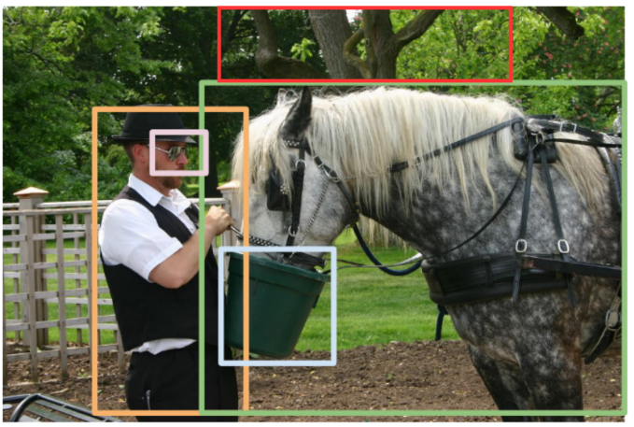
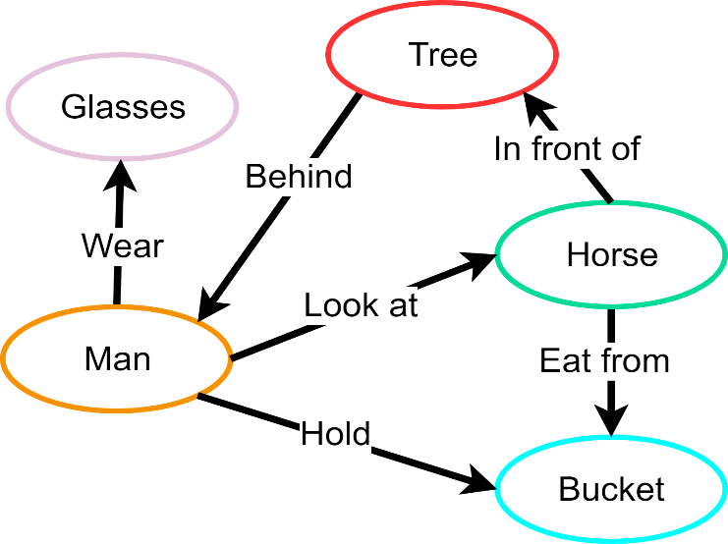
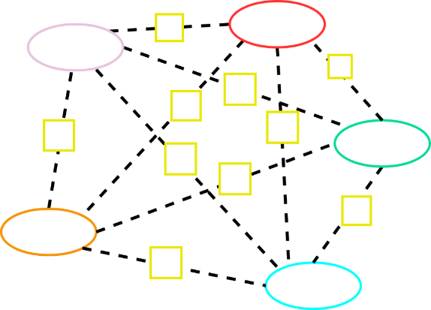
CV and Graphs
Input Image
Scene Graph
Neighbor Aggregation

Slide 6

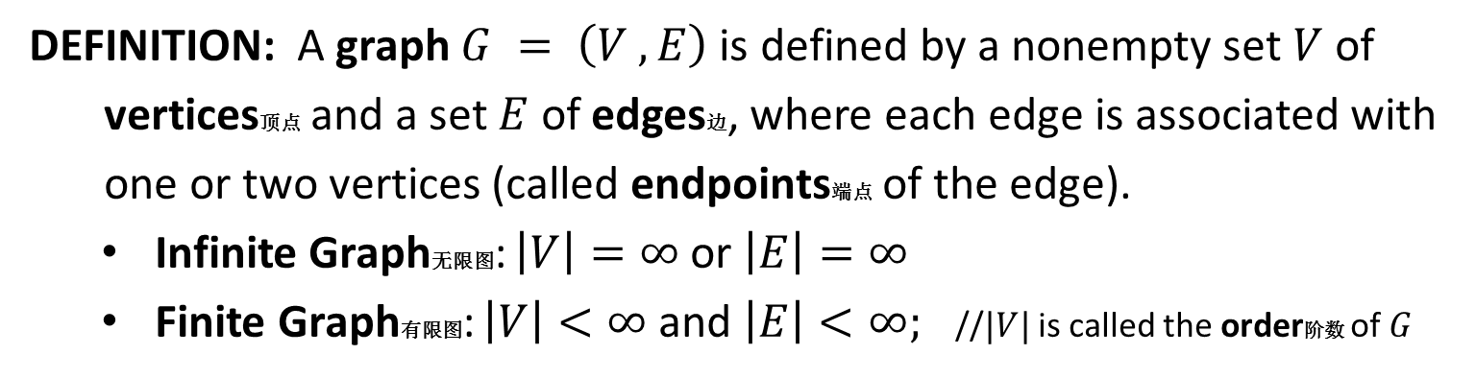



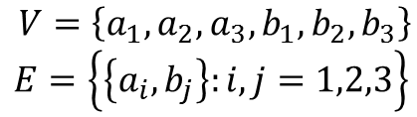



Graph
DEFINITION: A graph $G = \left(V ,E\right)$ is defined by a nonempty set $V$ of
vertices顶点 and a set $E$ of edges边, where each edge is associated with
one or two vertices (called endpoints端点 of the edge).
Infinite Graph无限图: $\left|V\right|=∞$ or $\left|E\right|=∞$
Finite Graph有限图: $\left|V\right|<∞$ and $\left|E\right|<∞;$ //$|V|$ is called the order阶数 of $G$
$$a_{1}$$
$$a_{2}$$
$$a_{3}$$
$$(1,1)$$
$$(0,0)$$
$$(1,0)$$
$$(−1,−1)$$
$$b_{1}$$
$$b_{2}$$
$$b_{3}$$
$V=\left\{a_{1},a_{2},a_{3},b_{1},b_{2},b_{3}\right\}$
$$E=\left\{\left\{a_{i},b_{j}\right\}:i,j=1,2,3\right\}$$
$V=\left\{\left(i,j\right):i,j∈ℤ\right\}$
$$E=\left\{\left\{\left(a,b\right),\left(c,d\right)\right\}:\left|a−c\right|=1 or \left|b−d\right|=1\right\}$$

Slide 7
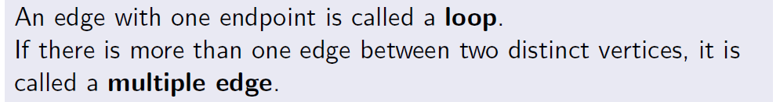
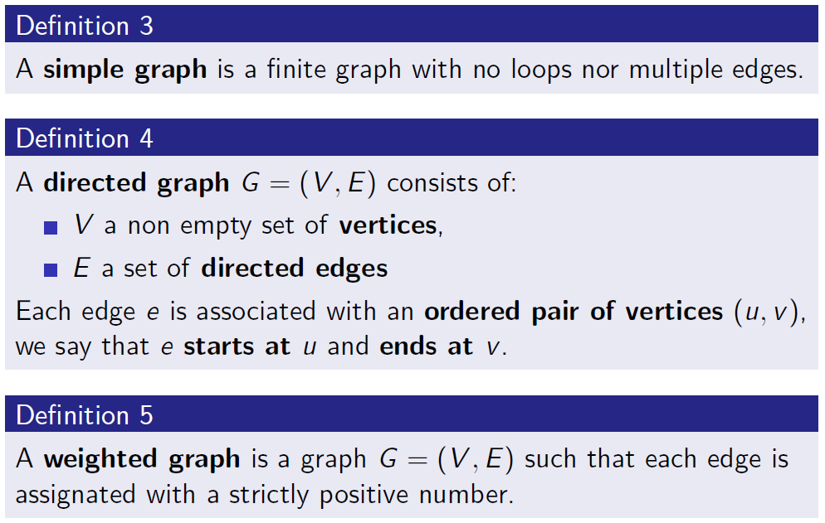
Graphs
Loop & multiple edge
Simple graph
Weighted graph

Slide 8
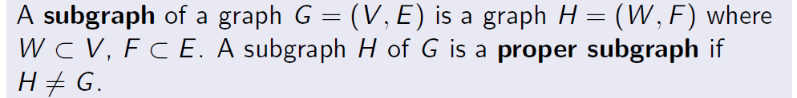
Graphs
Directed graph
Subgraph

Slide 9
Graph Examples
Acquaintanceship Graph:

Slide 10
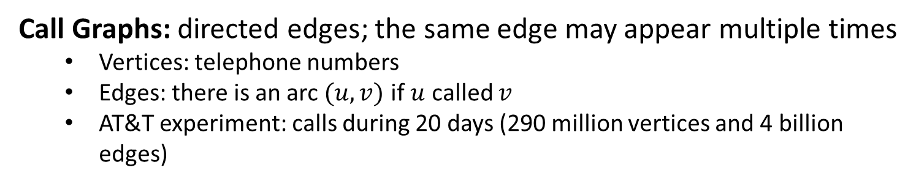
Graph Examples
Call Graphs: directed edges; the same edge may appear multiple times
Vertices: telephone numbers
Edges: there is an arc $(u,v)$ if $u$ called $v$
AT&T experiment: calls during 20 days (290 million vertices and 4 billion edges)

Slide 11
Graph Examples
Precedence Graph

Slide 12
Graph Examples
Flights

Slide 13
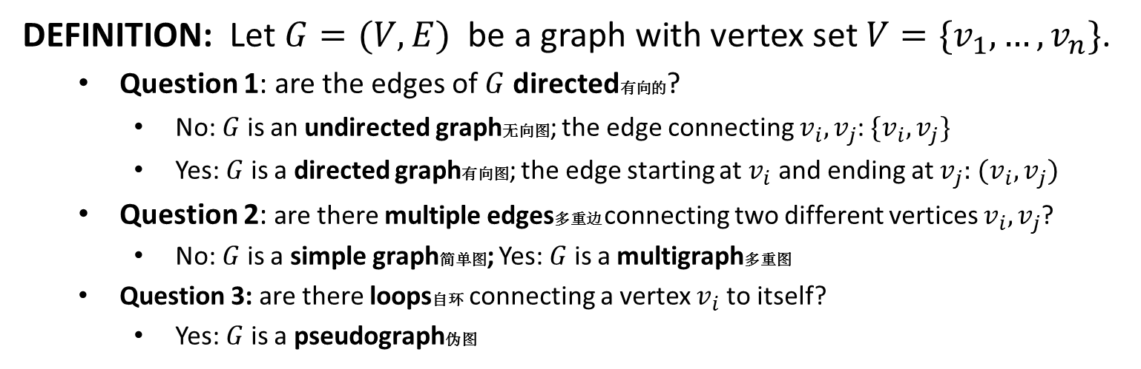
Types of Graphs
DEFINITION: Let $G=(V,E)$ be a graph with vertex set $V=\{v_{1},…,v_{n}\}$.
Question 1: are the edges of $G$ directed有向的?
No: $G$ is an undirected graph无向图; the edge connecting $v_{i},v_{j}$: $\{v_{i},v_{j}\}$
Yes: $G$ is a directed graph有向图; the edge starting at $v_{i}$ and ending at $v_{j}:$ $(v_{i},v_{j})$
Question 2: are there multiple edges多重边 connecting two different vertices $v_{i},v_{j}$?
No: $G$ is a simple graph简单图; Yes: $G$ is a multigraph多重图
Question 3: are there loops自环 connecting a vertex $v_{i}$ to itself?
Yes: $G$ is a pseudograph伪图
Type | Edges | Multiple Edges Allowed? | Loops Allowed?
Simple graph | undirected | No | No
Multigraph | undirected | Yes | No
Pseudograph | undirected | Yes | Yes
Simple directed graph | directed | No | No
Directed multigraph | directed | Yes | Yes
Mixed graph | undirected + directed | Yes | Yes

Slide 14

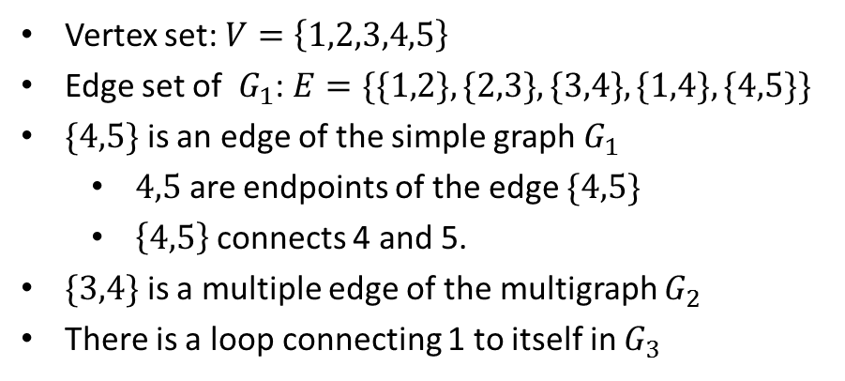


Types of Graphs
1
1
2
4
5
2
4
5
3
3
A Simple Graph ($G_{1}$)
A Pseudograph ($G_{3}$)
1
Vertex set: $V=\left\{1,2,3,4,5\right\}$
Edge set of $G_{1}$: $E=\{\{1,2\},\{2,3\},\{3,4\},\{1,4\},\{4,5\}\}$
$\{4,5\}$ is an edge of the simple graph $G_{1}$
$4,5$ are endpoints of the edge $\{4,5\}$
$\left\{4,5\right\}$connects 4 and 5.
$\{3,4\}$ is a multiple edge of the multigraph $G_{2}$
There is a loop connecting 1 to itself in $G_{3}$
2
4
5
3
A Multigraph ($G_{2}$)

Slide 15

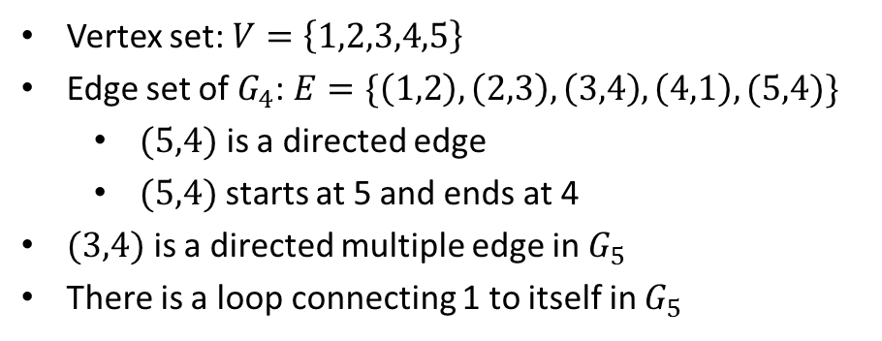


Types of Graphs
1
1
2
4
5
2
4
5
3
3
A Simple Directed Graph ($G_{4}$)
A Mixed Graph ($G_{6}$)
1
Vertex set: $V=\left\{1,2,3,4,5\right\}$
Edge set of $G_{4}$: $E=\{\left(1,2\right),\left(2,3\right), \left(3,4\right), \left(4,1\right), (5,4)\}$
$(5,4)$ is a directed edge
$(5,4)$starts at 5 and ends at 4
$(3,4)$ is a directed multiple edge in $G_{5}$
There is a loop connecting 1 to itself in $G_{5}$
2
4
5
3
A Directed Multigraph ($G_{5}$)

Slide 16
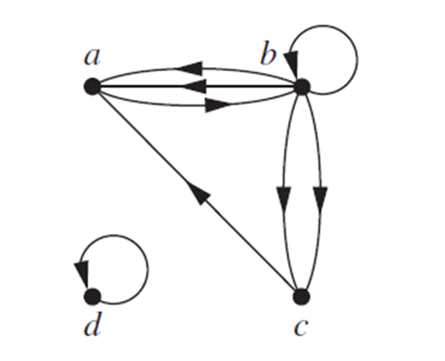
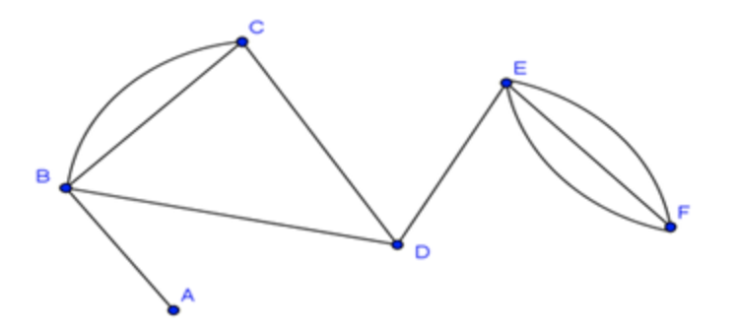
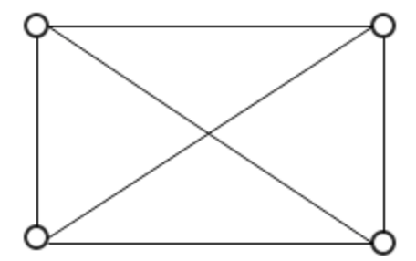
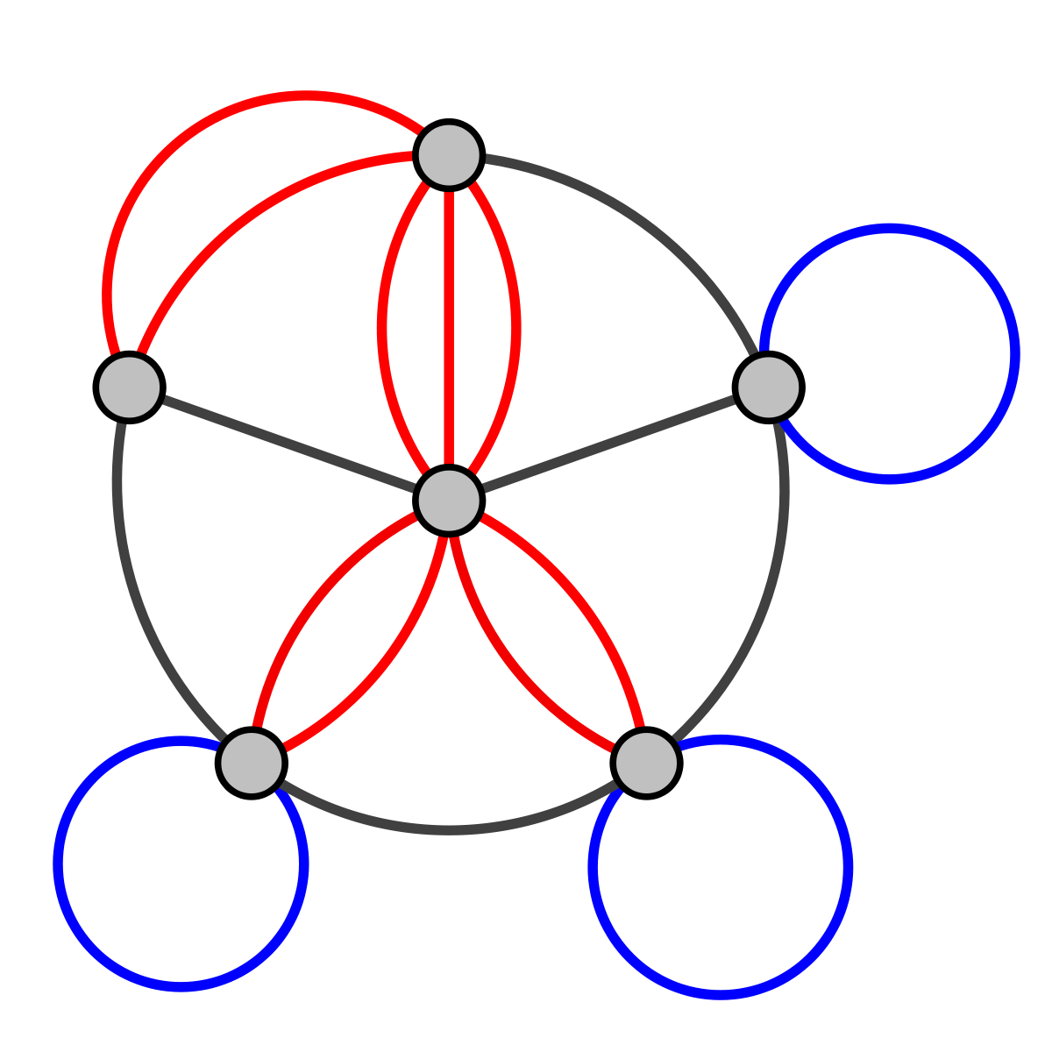
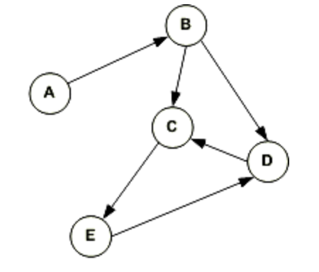
Bonus exercise
（1）simple graph
（3）multigraph
（5）directed multigraph
（2）pseudograph
（4）simple directed graph

Slide 17
Special Simple Graphs
Complete Graph完全图 $K_{n}$: $V=\left\{v_{1}, …,v_{n}\right\};$ $E=\left\{\left\{v_{i},v_{j}\right\}:1≤i≠j≤n\right\}$
Cycle环,圈 $C_{n}$: $V=\left\{v_{1},v_{2},…,v_{n}\right\}$; $E=\left\{\left\{v_{1}v_{2}\right\}, \left\{v_{2},v_{3}\right\},…,\left\{v_{n}, v_{1}\right\}\right\}$

Slide 18
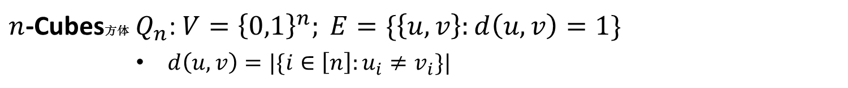
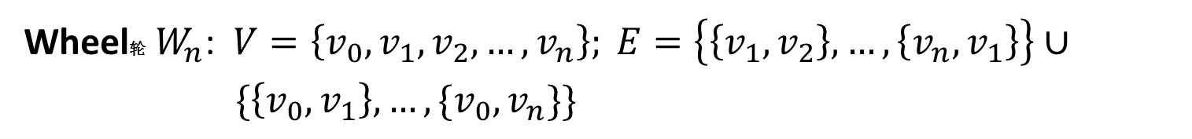
Special Simple Graphs
Wheel轮 $W_{n}$: $V=\left\{v_{0},v_{1},v_{2},…,v_{n}\right\}; E=\left\{\left\{v_{1},v_{2}\right\},…,\left\{v_{n},v_{1}\right\}\right\}∪$
$\{\left\{v_{0},v_{1}\right\},…,\{v_{0},v_{n}\}\}$
$n$-Cubes方体 $Q_{n}$: $V={\left\{0,1\right\}}^{n}; E=\{\left\{u,v\right\}:d\left(u,v\right)=1\}$
$d\left(u,v\right)=|\{i∈\left[n\right]:u_{i}≠v_{i}\}|$

Slide 19
Adjacency List
DEFINITION: Let $G=(V,E)$ be a graph with no multiple edges. The
adjacency list邻接表 of $G$ is a list the vertices of the graph and all
adjacent vertices
$v_{i},v_{j}∈V$ are adjacent相邻的 if $\{v_{i},v_{j}\}$ or $(v_{i},v_{j})$ is an edge
$$a$$ | $$b,c,e$$
$$b$$ | $$a$$
$$c$$ | $$a,d,e$$
$$d$$ | $$c,e$$
$$e$$ | $$a,c,d$$
$$a$$ | $$b,c,d,e$$
$$b$$ | $$b,d$$
$$c$$ | $$a,c,e$$
$$d$$
$$e$$ | $$b,c,d$$

Slide 20

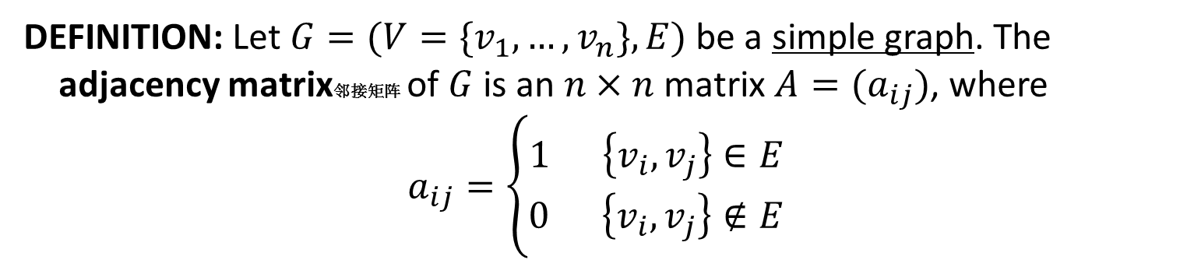




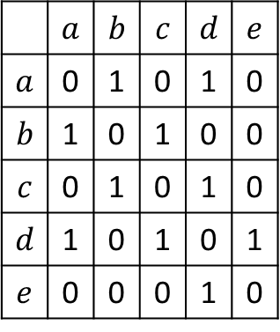
Adjacency Matrix
DEFINITION: Let $G=(V=\{v_{1},…,v_{n}\},E)$ be a simple graph. The
adjacency matrix邻接矩阵 of $G$ is an $n×n$ matrix $A=(a_{ij})$, where
$$a_{ij}=\left\{\begin{aligned}1 \left\{v_{i},v_{j}\right\}∈E \\ 0 \left\{v_{i},v_{j}\right\}∉E\end{aligned}\right.$$
 | $$a$$ | $$b$$ | $$c$$ | $$d$$ | $$e$$
$$a$$ | 0 | 1 | 0 | 1 | 0
$$b$$ | 1 | 0 | 1 | 0 | 0
$$c$$ | 0 | 1 | 0 | 1 | 0
$$d$$ | 1 | 0 | 1 | 0 | 1
$$e$$ | 0 | 0 | 0 | 1 | 0
$$a$$
$$b$$
$$d$$
$$e$$
$$c$$

Slide 21
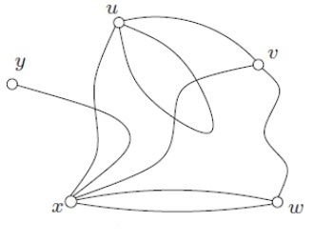
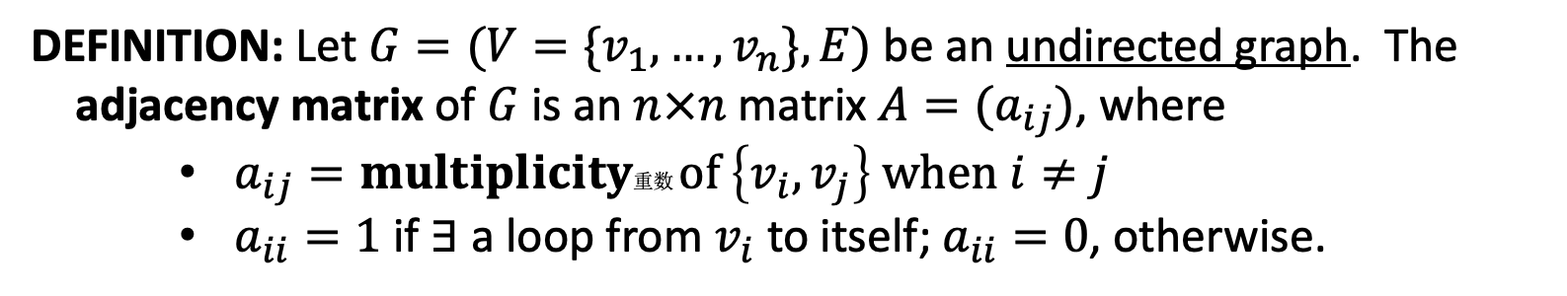
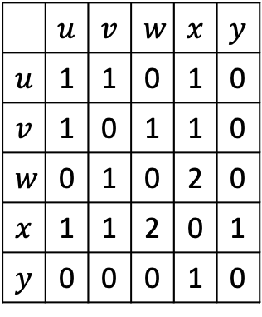
Adjacency Matrix
DEFINITION: Let $G=(V=\{v_{1},…,v_{n}\},E)$ be an undirected graph. The
adjacency matrix of $G$ is an $n×n$ matrix $A=(a_{ij})$, where
$a_{ij}=multiplicity$重数 $of \left\{v_{i},v_{j}\right\} when i≠j$
$a_{ii}=1$ if $∃$ a loop from $v_{i}$ to itself; $a_{ii}=0$, otherwise.
 | $$u$$ | $$v$$ | $$w$$ | $$x$$ | $$y$$
$$u$$ | 1 | 1 | 0 | 1 | 0
$$v$$ | 1 | 0 | 1 | 1 | 0
$$w$$ | 0 | 1 | 0 | 2 | 0
$$x$$ | 1 | 1 | 2 | 0 | 1
$$y$$ | 0 | 0 | 0 | 1 | 0

Slide 22
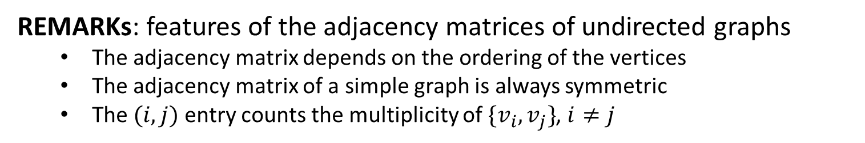
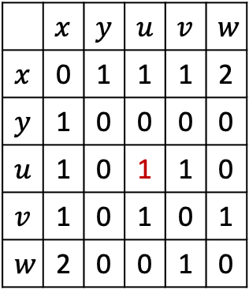
Adjacency Matrix
DEFINITION: Let $G=(V=\{v_{1},…,v_{n}\},E)$ be an undirected graph. The
adjacency matrix of $G$ is an $n×n$ matrix $A=(a_{ij})$, where
$a_{ij}=multiplicity$重数 $of \left\{v_{i},v_{j}\right\} when i≠j$
$a_{ii}=1$ if $∃$ a loop from $v_{i}$ to itself; $a_{ii}=0$, otherwise.
 | $$x$$ | $$y$$ | $$u$$ | $$v$$ | $$w$$
$$x$$ | 0 | 1 | 1 | 1 | 2
$$y$$ | 1 | 0 | 0 | 0 | 0
$$u$$ | 1 | 0 | 1 | 1 | 0
$$v$$ | 1 | 0 | 1 | 0 | 1
$$w$$ | 2 | 0 | 0 | 1 | 0
REMARKs: features of the adjacency matrices of undirected graphs
The adjacency matrix depends on the ordering of the vertices
The adjacency matrix of a simple graph is always symmetric
The $(i,j)$ entry counts the multiplicity of $\{v_{i},v_{j}\}$, $i≠j$

Slide 23

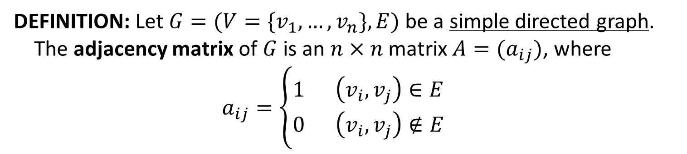




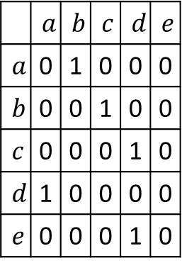
Adjacency Matrix
DEFINITION: Let $G=(V=\{v_{1},…,v_{n}\},E)$ be a simple directed graph.
The adjacency matrix of $G$ is an $n×n$ matrix $A=(a_{ij})$, where
$a_{ij}=\left\{\begin{aligned}1 \left(v_{i},v_{j}\right)∈E \\ 0 \left(v_{i},v_{j}\right)∉E\end{aligned}\right.$
 | $$a$$ | $$b$$ | $$c$$ | $$d$$ | $$e$$
$$a$$ | 0 | 1 | 0 | 0 | 0
$$b$$ | 0 | 0 | 1 | 0 | 0
$$c$$ | 0 | 0 | 0 | 1 | 0
$$d$$ | 1 | 0 | 0 | 0 | 0
$$e$$ | 0 | 0 | 0 | 1 | 0
$$a$$
$$b$$
$$d$$
$$e$$
$$c$$
REMARKS: The adjacency matrix is no longer symmetric

Slide 24

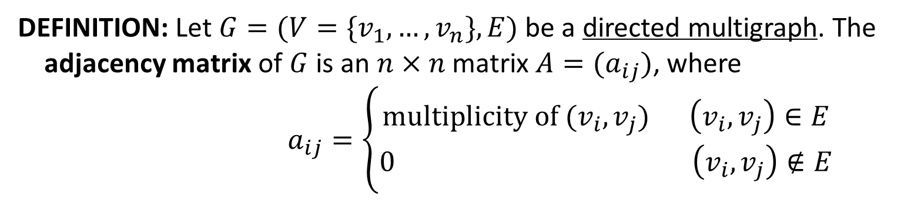



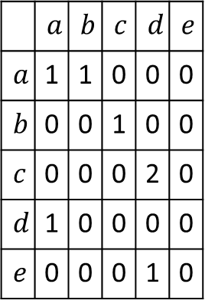

Adjacency Matrix
DEFINITION: Let $G=(V=\{v_{1},…,v_{n}\},E)$ be a directed multigraph. The
adjacency matrix of $G$ is an $n×n$ matrix $A=(a_{ij})$, where
$a_{ij}=\left\{\begin{aligned}multiplicity of (v_{i},v_{j}) \left(v_{i},v_{j}\right)∈E \\ 0 \left(v_{i},v_{j}\right)∉E\end{aligned}\right.$
 | $$a$$ | $$b$$ | $$c$$ | $$d$$ | $$e$$
$$a$$ | 1 | 1 | 0 | 0 | 0
$$b$$ | 0 | 0 | 1 | 0 | 0
$$c$$ | 0 | 0 | 0 | 2 | 0
$$d$$ | 1 | 0 | 0 | 0 | 0
$$e$$ | 0 | 0 | 0 | 1 | 0
$$a$$
$$b$$
$$d$$
$$e$$
$$c$$

Slide 25
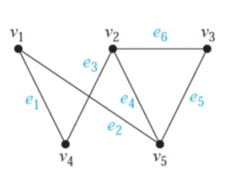
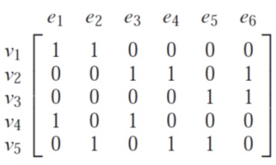
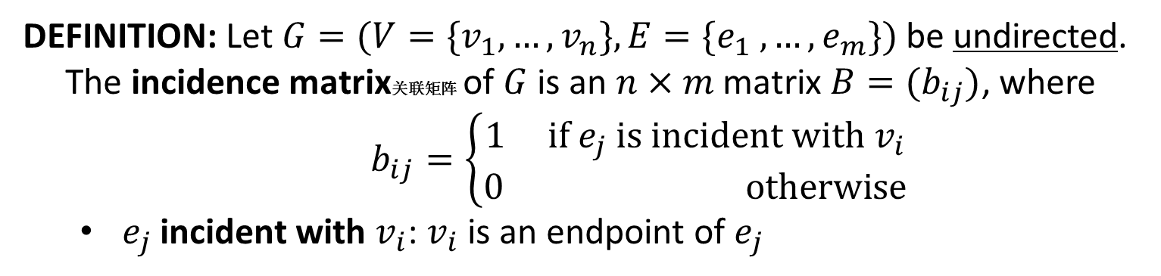
Incidence Matrix
DEFINITION: Let $G=(V=\{v_{1},…,v_{n}\},E=\{e_{1} ,…,e_{m}\})$ be undirected.
The incidence matrix关联矩阵 of $G$ is an $n×m$ matrix $B=(b_{ij})$, where
$b_{ij}=\left\{\begin{aligned}1 if e_{j} is incident with v_{i} \\ 0 otherwise\end{aligned}\right.$
$e_{j}$ incident with $v_{i}$: $v_{i}$ is an endpoint of $e_{j}$

Slide 26
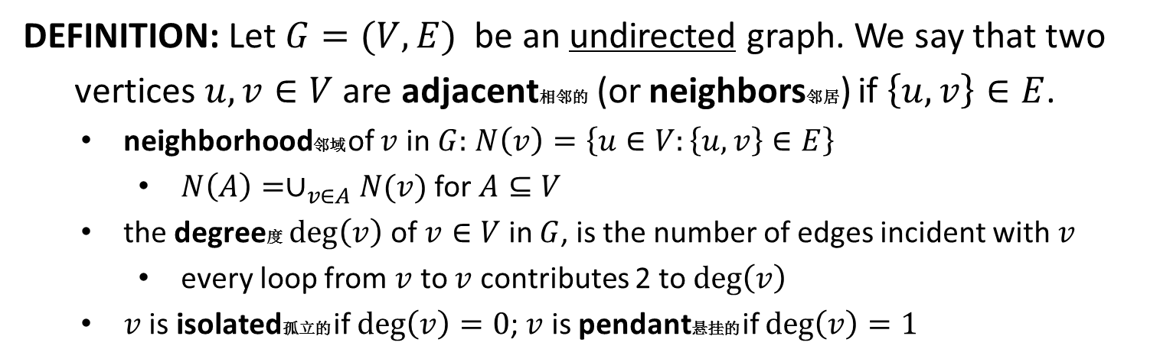
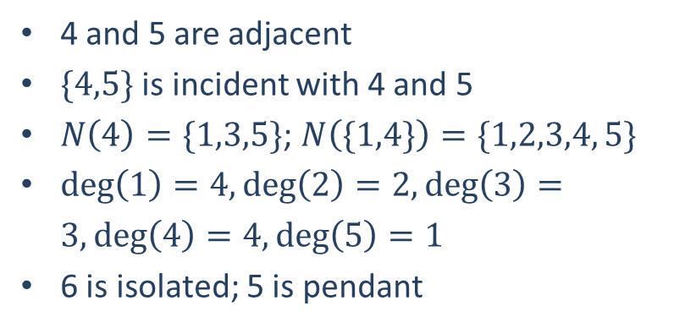
Degree
DEFINITION: Let $G=(V,E)$ be an undirected graph. We say that two
vertices $u,v∈V$ are adjacent相邻的 (or neighbors邻居) if $\left\{u,v\right\}∈E$.
neighborhood邻域 of $v$ in $G:$ $N\left(v\right)=\left\{u∈V:\left\{u,v\right\}∈E\right\}$
$N\left(A\right)=∪_{v∈A}N(v)$ for $A⊆V$
the degree度 $\deg\left(v\right)$ of $v∈V$ in $G$, is the number of edges incident with $v$
every loop from $v$ to $v$ contributes 2 to $\deg\left(v\right)$
$v$ is isolated孤立的 if $\deg\left(v\right)=0$; $v$ is pendant悬挂的 if $\deg\left(v\right)=1$
4 and 5 are adjacent
$\{4,5\}$ is incident with 4 and 5
$N\left(4\right)=\{1,3,5\}$; $N\left(\{1,4\}\right)=\{1,2,3,4, 5\}$
$\deg\left(1\right)=4,\deg\left(2\right)=2,\deg\left(3\right)=3,\deg\left(4\right)=4,\deg\left(5\right)=1$
6 is isolated; 5 is pendant
1
2
4
5
6
3

Slide 27
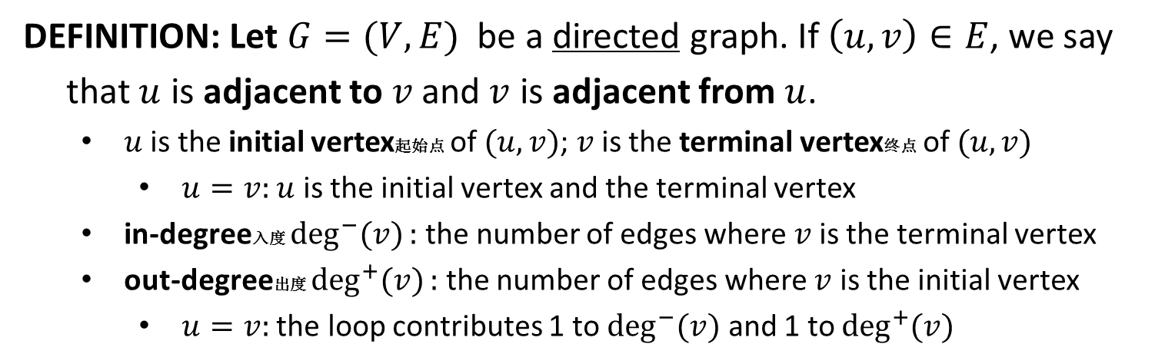
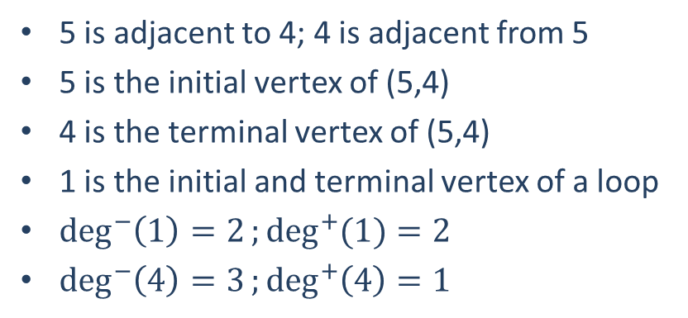
Degree
DEFINITION: Let $G=(V,E)$ be a directed graph. If $\left(u, v\right)∈E$, we say
that $u$ is adjacent to$v$and $v$ is adjacent from $u$.
$u$ is the initial vertex起始点 of $(u, v)$; $v$ is the terminal vertex终点 of $(u, v)$
$u=v:$ $u$ is the initial vertex and the terminal vertex
in-degree入度 $\deg^{−}{(v)}:$ the number of edges where$v$is the terminal vertex
out-degree出度 $\deg^{+}{(v)}:$ the number of edges where $v$ is the initial vertex
$u=v:$ the loop contributes 1 to $\deg^{−}{(v)}$ and 1 to $\deg^{+}{(v)}$
5 is adjacent to 4; 4 is adjacent from 5
5 is the initial vertex of (5,4)
4 is the terminal vertex of (5,4)
1 is the initial and terminal vertex of a loop
$\deg^{−}\left(1\right)=2;\deg^{+}{(1)}=2$
$\deg^{−}\left(4\right)=3;\deg^{+}\left(4\right)=1$
1
2
4
5
6
3

Slide 28
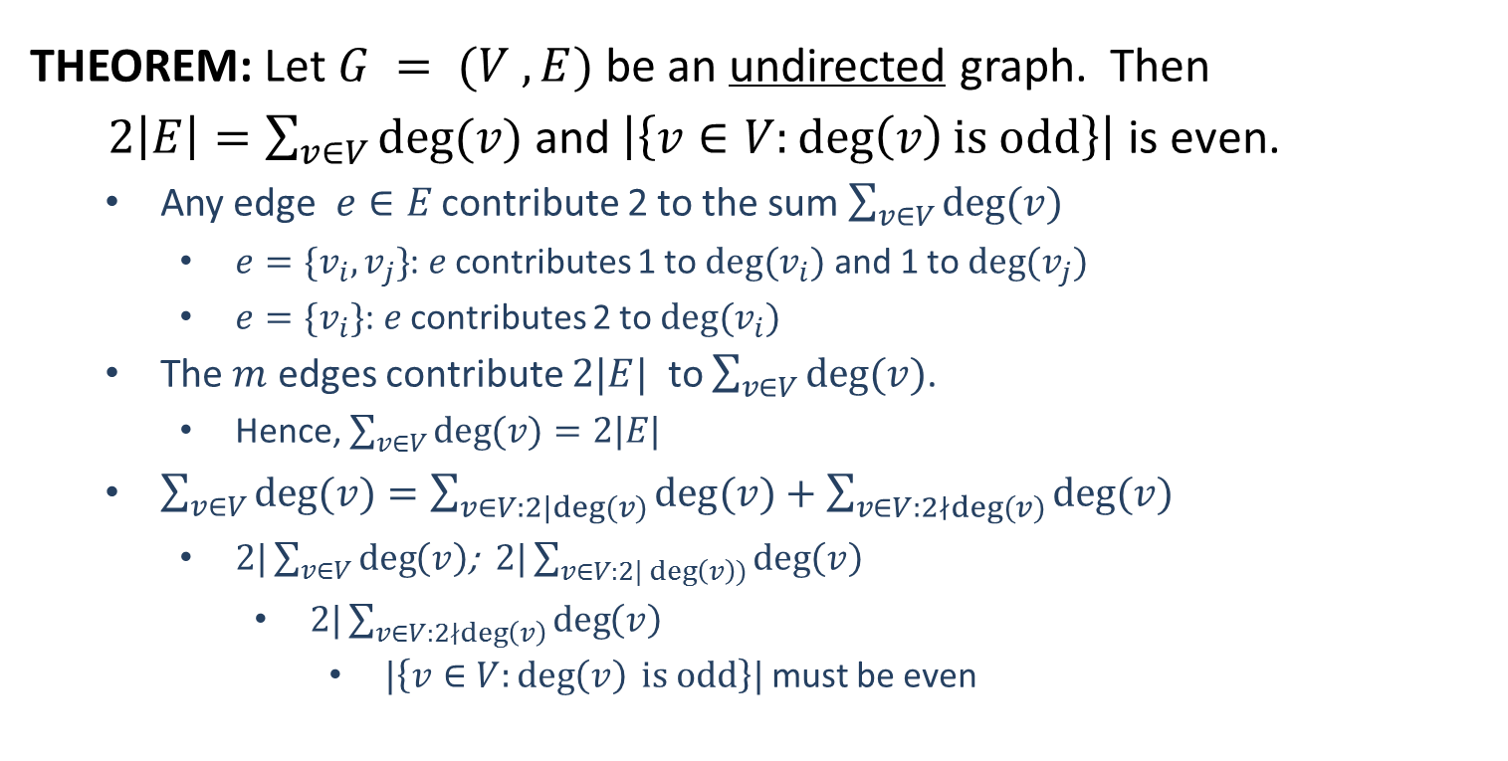
Handshaking Theorem
THEOREM: Let $G = (V ,E)$be an undirected graph. Then
$2\left|E\right|=\sum_{v∈V}{deg⁡(v)}$ and $\left|\left\{v∈V:\deg\left(v\right)is odd\right\}\right|$ is even.
Any edge $e∈E$ contribute 2 to the sum $\sum_{v∈V}{\deg{(v)}}$
$e=\{v_{i},v_{j}\}$: $e$ contributes 1 to $deg⁡(v_{i})$ and 1 to $deg⁡(v_{j})$
$e=\{v_{i}\}$: $e$ contributes 2 to $deg⁡(v_{i})$
The $m$ edges contribute $2|E|$ to $\sum_{v∈V}{\deg{(v)}}$.
Hence, $\sum_{v∈V}{\deg{(v)}}=2|E|$
$\sum_{v∈V}{\deg{(v)}}=\sum_{v∈V:2|deg⁡(v)}{\deg{(v)}+\sum_{v∈V:2∤deg⁡(v)}{\deg{(v)}}}$
$2|\sum_{v∈V}{\deg\left(v\right)}$; $2|\sum_{v∈V:2|\deg\left(v\right))}{\deg\left(v\right)}$
$2|\sum_{v∈V:2∤\deg\left(v\right)}{\deg\left(v\right)}$
$|\left\{v∈V:\deg\left(v\right) is odd\right\}|$ must be even

Slide 29
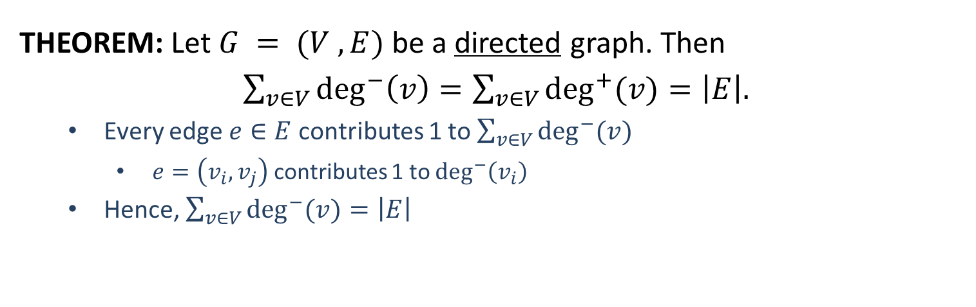

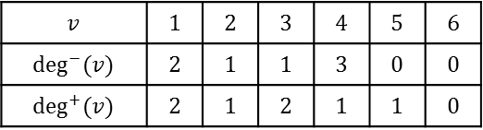
Handshaking Theorem
THEOREM: Let $G = (V ,E)$be a directed graph. Then
$\sum_{v∈V}{\deg^{−}\left(v\right)=\sum_{v∈V}{\deg^{+}{(v)}}}=\left|E\right|.$
Every edge $e∈E$ contributes 1 to $\sum_{v∈V}{\deg^{−}{(v)}}$
$e=\left(v_{i},v_{j}\right)$ contributes 1 to $\deg^{−}\left(v_{i}\right)$
Hence, $\sum_{v∈V}{\deg^{−}{(v)}}=\left|E\right|$
1
1
2
4
5
6
2
4
5
6
3
3
$$v$$ | $$1$$ | $$2$$ | $$3$$ | $$4$$ | $$5$$ | $$6$$
$$deg(v)$$ | $$4$$ | $$2$$ | $$3$$ | $$4$$ | $$1$$ | $$0$$
$$v$$ | $$1$$ | $$2$$ | $$3$$ | $$4$$ | $$5$$ | $$6$$
$$\deg^{−}⁡(v)$$ | $$2$$ | $$1$$ | $$1$$ | $$3$$ | $$0$$ | $$0$$
$$\deg^{+}⁡(v)$$ | $$2$$ | $$1$$ | $$2$$ | $$1$$ | $$1$$ | $$0$$

